Slide 1
Power Automate Cloud Flows

Slide 2
Module Agenda
Create and Manage Cloud Flows
Flow Logic
Advanced Flow Scenarios
Deploy and Monitor

Slide 3
Module 1: Create and Manage Cloud Flows

Slide 4
Module 1 – Introduction
Power Automate Cloud Flows is an online workflow service that automates actions across the most common apps and services​ enabling users to synchronize files, get notifications, collect data, and more, all without needing to write code.
In this module, you will:
1
Create a cloud flow
2
Identify the different trigger types for cloud flows
3
Run and test a cloud flow
4
Debug solutions by using Power Automate cloud flows debugging features

Slide 5




Types of Power Automate Flows
Automated Flows
Instant Flows
Scheduled Flows
Desktop Flows
Cloud Flows
Notes:
More on the types here https://docs.microsoft.com/en-us/power-automate/getting-started#types-of-flows
Automated flows – For example, on create of a project estimate row run the automation
Instant flows – For example, From the Power Automate mobile app users can click a button to run the flow on demand to start a new project estimate
Scheduled flows For example, run a weekly flow to expire old estimates

Slide 6
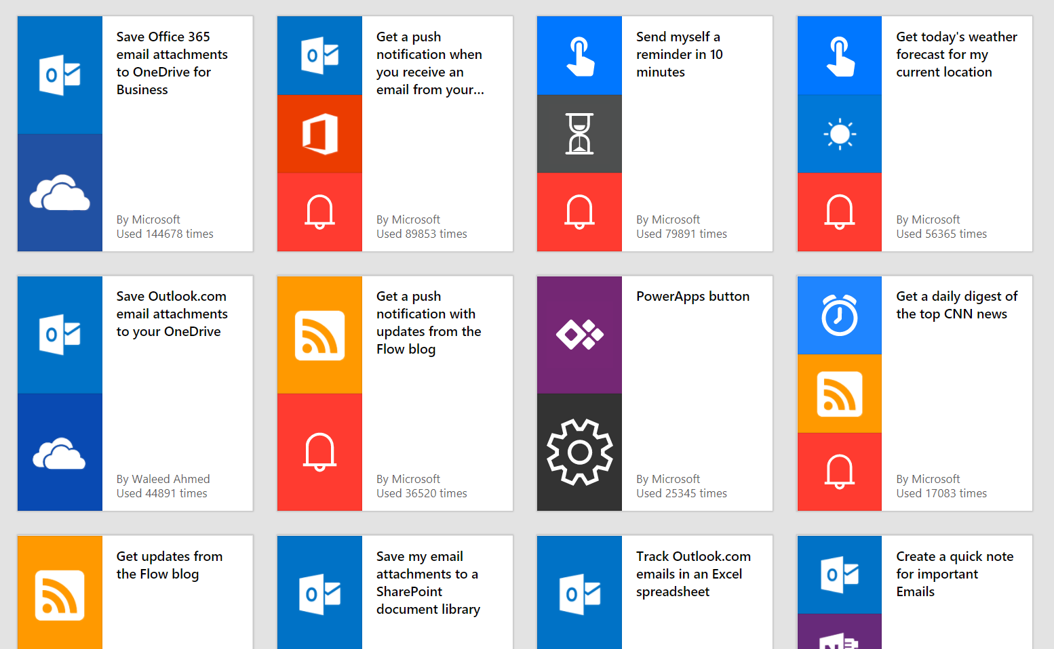
Get Started Fast
Start automating quickly with preconfigured templates
Notes:
Learn how to submit a template here https://docs.microsoft.com/en-us/power-automate/publish-a-template

Slide 7

1000+ Connectors
Connect to 1st and 3rd party services with built-in connectors for everything from Adobe to Zendesk to on-premises solutions.
Notes:
Not only is Power Automate a part of the robust Microsoft ecosystem, but with it, you’ll be able to take advantage of a huge array of certified Microsoft partners. There’s loads more to connectors to learn, we even have 2 modules about them in this course.

Slide 8

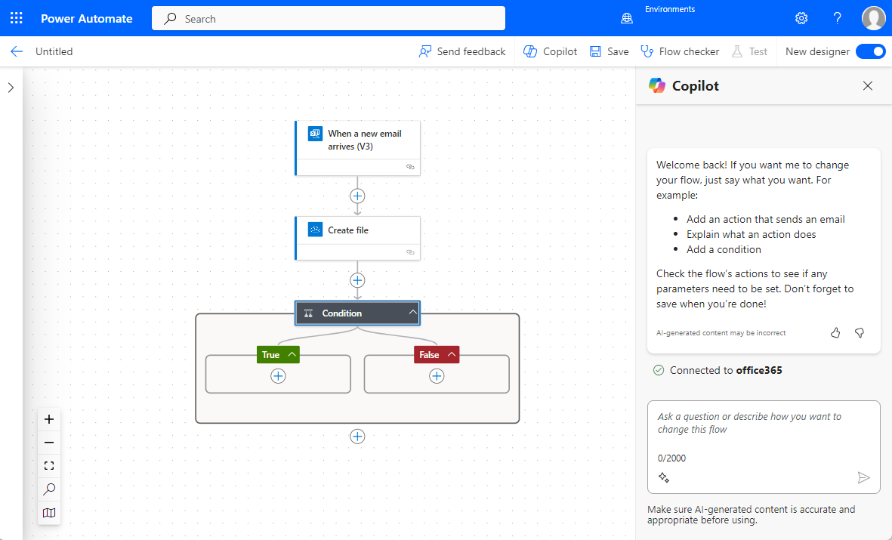
Building Blocks of a Flow
Trigger
Action
Conditional
Logic
Notes:
Here is the basic Power Automate UI where you can see a trigger, an action, and the conditional logic.
In this case, the trigger occurs when a new email arrives. When an email arrives an automated action is taken which in this case is the creation of a file. The conditional logic is a IF THEN function which offers a yes or no option for the flow process to execute depending on the criteria.

Slide 9
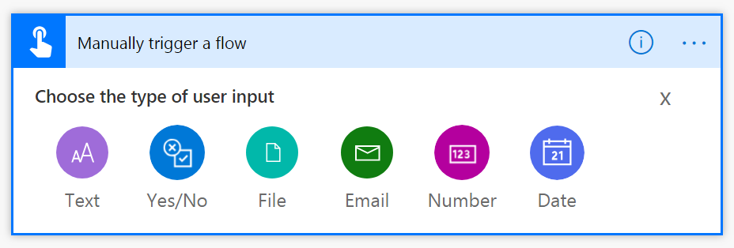
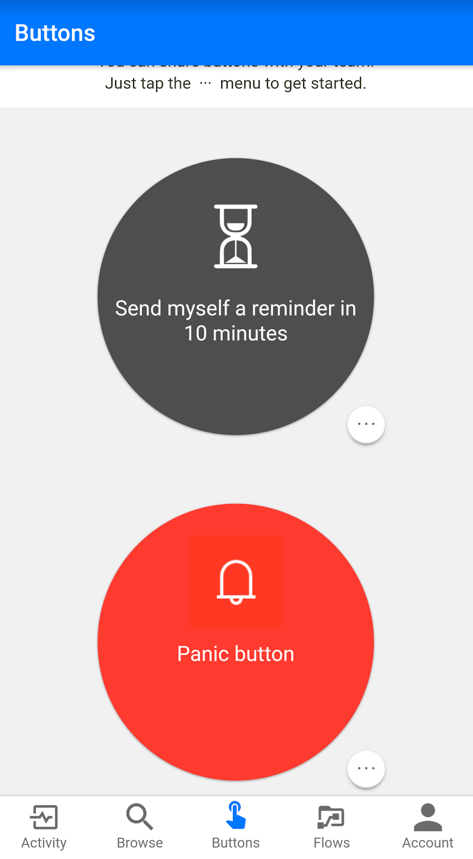
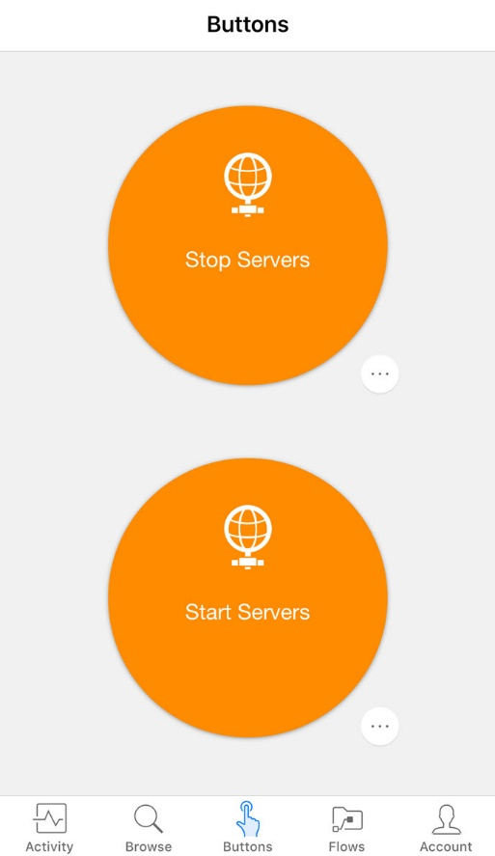
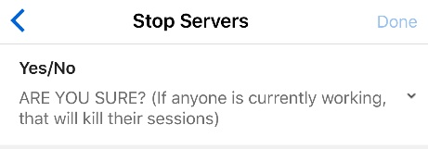
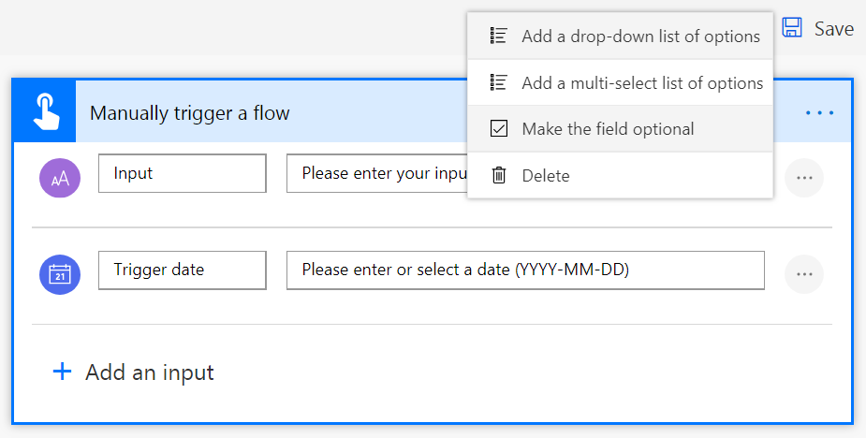
Instant Flows – Input Data
Notes:
Using the manual trigger you can add parameters that are prompted to the user when they run the flow.

Slide 10
Microsoft Dataverse Connectors
Microsoft Dataverse (Legacy)
Use when you need to integrate across environments
Microsoft Dataverse
Use when talking to Microsoft Dataverse in the same environment
This is the preferred connector to use and will replace the other connector
Need to use for When a row is selected
Notes:
With many possible connectors, it may seem confusing. The quick answer is use the Microsoft Dataverse connector on the bottom of our list if at all possible.
The first two connectors are deprecated and should only be used for scenarios that can’t be handled by Microsoft Dataverse

Slide 11

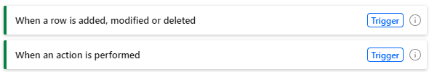
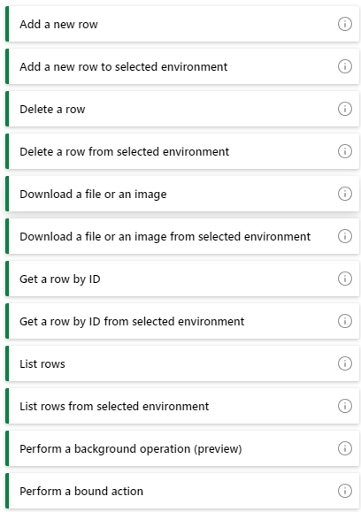
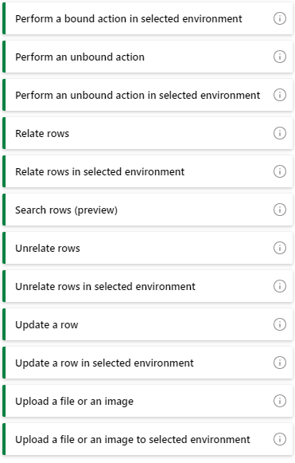
Microsoft Dataverse Triggers and Actions
Triggers
Actions
Notes:
Read thru some of these and engage with students on what they might use any given connector for.
The Dataverse triggers are:
When a flow step is run from a business process flow - This trigger allows you to start a flow when the Run Flow button in a business process flow step is clicked.
When a row is added, modified, or deleted - This trigger allows you to start a flow when a row is added, modified, or deleted in a Microsoft Dataverse table, such that it matches the selected options.
When an action is performed (preview) - Triggers when a Microsoft Dataverse action has completed.
The Dataverse actions are:
Add a new row - This action allows you to add a new row in the selected Microsoft Dataverse table.
Delete a row - This action allows you to delete a row from a Microsoft Dataverse table.
Download a file or an image - This action allows you to download a file or an image content from a Microsoft Dataverse table.
Get a row by ID - This action allows you to get the row that matches an ID in a Microsoft Dataverse table.
List rows - This action allows you to list the rows in a Microsoft Dataverse table that match the selected options.
Perform a bound action - This action allows you to perform Microsoft Dataverse actions associated with a selected table.
Perform an unbound action - This action allows you to perform Microsoft Dataverse actions available in the environment that aren't associated with any table.
Relate rows - This action allows you to link a row in one Microsoft Dataverse table to another if the tables have a one-to-many or many-to-many relationship.
Search rows (preview) - This action allows you to search a Microsoft Dataverse environment using Relevance Search, and returns the rows that match the search term most closely.
Unrelate rows - This action allows you to remove the link between a row in one Microsoft Dataverse table to another if the tables have a one-to-many or many-to-many relationship.
Update a row - This action allows you to modify any selected row in a Microsoft Dataverse table, or adds a new row if it doesn't exist.
Upload a file or an image - This action allows you to upload a file or an image content to a Microsoft Dataverse table with a compatible column type.
Perform a changeset request - This action allows you to perform a group of Microsoft Dataverse connector operations as a single transaction. If one of the operations fails, all the successful actions are rolled back.
Dataverse actions in Power Automate allow you to create robust processes that surround your data.

Slide 12

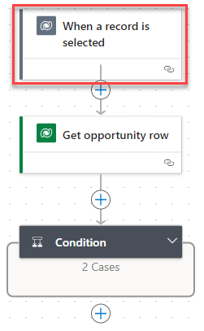
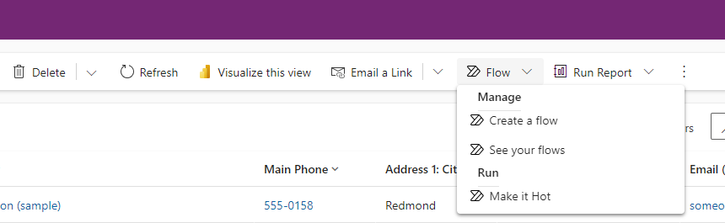
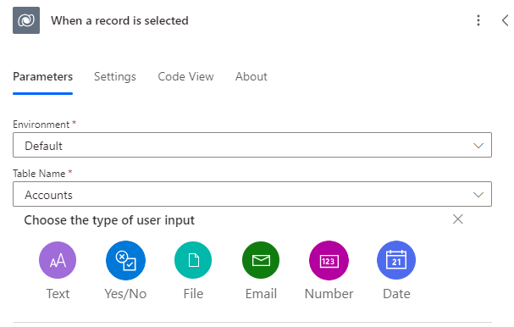
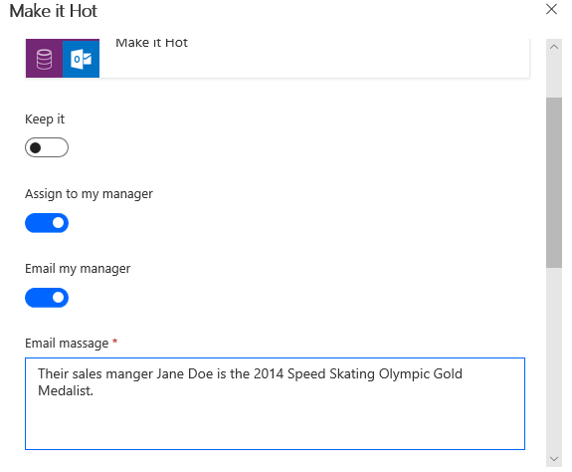
Run flows on selected records trigger
Notes:
This can in many cases replace what you would use Microsoft Dataverse Dialog for , since dialogs are now deprecated
Note: Default for Organization Name is still used on this trigger and is the same as (Current)

Slide 13
Power Automate Cloud Flows Debugging Features
1
Run History
Displays flow execution details, including input, output, and error messages of each action.
2
Test Feature
Helps reproduce issues by running a flow with previously captured trigger events.
3
Compose Actions
Captures variable values or expressions at any point, visible in the run history for debugging.
4
Error Handling and Alerts
Configures steps and alerts to handle failures and exceptions during the flow's operation.
5
Tracked Properties
Advanced feature for logging additional insights about flow's state during its execution.
Notes:
This would be a good place for a demo of testing and debugging a flow

Slide 14
Exercise: Create your First Flow
Follow the exercise on Learn
Time estimate: 15 minutes
Notes:
https://learn.microsoft.com/en-us/training/modules/get-started-flows/flow-monitor-incoming-emails

Slide 15
Module 1 – Summary
How to create a cloud flow
Understand the different trigger types for cloud flows
How to run and test a cloud flow
How to debug solutions by using Power Automate cloud flows debugging features

Slide 16
Module 2: Flow Logic

Slide 17
Module 2 – Introduction
Setup and manage flow controls, actions, data parsing, and configurations including handling both system and business exceptions within cloud flows.
In this module, you will:
1
Configure flow control in cloud flows including loops
2
Configure expressions in cloud flows
3
Identify common processes for parsing text including JSON, XML, and CSV in cloud flows
4
Configure variable actions for cloud flows
5
Implement data objects in cloud flows
6
Configure timeout and retry policies in cloud flows
7
Create exception handling blocks in cloud flows to handle system exceptions
8
Create error handling routines in cloud flows to handle business exceptions
Notes:
Prerequisites
Basic familiarity with the Power Automate for desktop console

Slide 18
Flow Building Fundamentals
Dynamic data
Variables
Looping
Error Handling
Conditions
Expressions
Notes:
Good place to talk though these at a high level

Slide 19
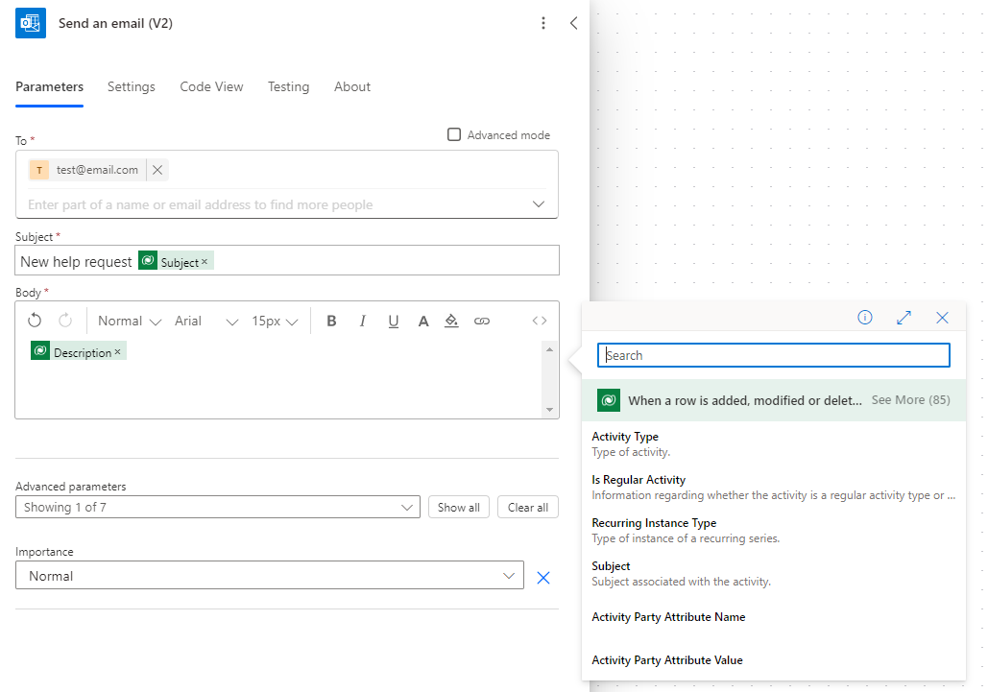
Dynamic Content
Notes:
Dynamic content allows us to use values from the flow we are building, or the data source to include in the flow downstream

Slide 20
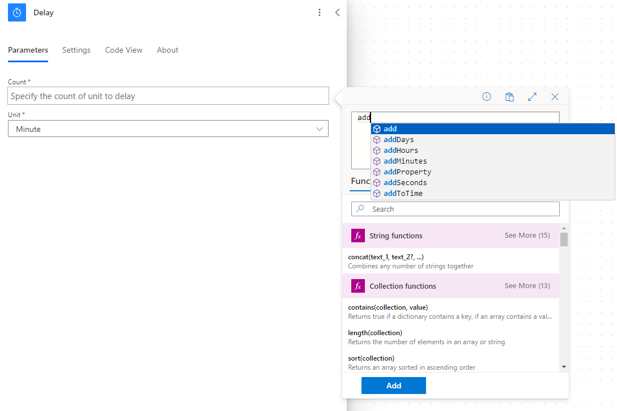
Expressions
Notes:
Expressions are the “low code” part of Power Automate. It is more like an Excel function
Many reasons to use expressions:
Convert types
Perform simple, inline calculations like string manipulation or arithmetic, or date/time manipulation
Generate data like the current time, a GUID or a random number
Handling optional values
“If” conditional statements / control flow
Working with lists

Slide 21
Many Reasons to Use Expressions
Convert types
Perform simple, inline calculations like string manipulation or arithmetic, or date/time manipulation
Generate data like the current time, a GUID, or a random number
Handling optional values
“If” conditional statements
Working with lists
Notes:
Expressions can also reduce the amount of real estate that you have on a canvas to leverage
Avoid excessive use of Variables which can impact performance

Slide 22
Power Automate vs Power Apps Power Fx Language
1
Both were inspired by Excel
2
Power Automate needs to work with JSON, so it has some different concepts
3
Some function names are the same, but many are different
4
Power Fx overloads operators like + but Power Automate does not
5
Any operation and operator are presented as action/function, e.g., for +
add(<summand_1>, <summand_2>)
6
In the future Power Fx use will extend to Power Automate
Notes:
It is also the same language that Logic Apps uses since Power Automate runs on top of Logic Apps platform
https://powerapps.microsoft.com/en-us/blog/introducing-microsoft-power-fx-the-low-code-programming-language-for-everyone/

Slide 23
Important Expressions
1
Azure Logic Apps and Power Automate
Power Automate is based on Azure Logic Apps
Expression functions are identical
Reference guide for expression functions
2
Important expressions
body(stepName) – Returns object with properties from a step
triggerBody() – Like body() but for trigger output
item() – Used to reference the current item in Apply to each
variables(variableName) – Reference a variable
parameters(parameterName) – Environment variable
Notes:
Important expressions
body(stepName)
Returns an object with all properties of a different action
triggerBody()
Like body() but for trigger output.
item()
Used to reference the current item in Apply to each
Also used for actions that take an array and manipulate them
variables(variableName)
Reference a variable
Worth calling out that when in the expression editor that you don't need the '@' sign
Could be interesting to show students how they can access existing paths by copying dynamic content or by using Peek code
For workflow definitions in Azure Logic Apps and Power Automate, some expressions get their values from runtime actions that might not yet exist when your workflow starts running. To reference or process the values in these expressions, you can use expression functions provided by the Workflow Definition Language.

Slide 24
Common Expressions
coalesce(<object_1>, <object_2>, ...) – Return first non-null value
guid() – Generate a GUID
replace(string, old, new) – Replace old with new in string
equals(left, right) – Returns true if left equals right
utcnow(‘yyyy-mm-dd’) – Generate a date/time
string() – Convert to plain/text
json() – Convert to application/json – Can parse like JSON
xml() – Convert to application/xml
xpath(<xml>, <expression>) – Execute Xpath expression
if(<condition>, <true>, <false>) – Set value based on condition
result(<scope>) – Return the run result for a scope of actions
Notes:
Coalesce is great to use when working with option set values because you can provide a default in case one isn't specified to avoid an error

Slide 25
Handling Optional Values
coalesce(body('Get_record')?['content'],'Default Value')
Caution: Trying to use a property that’s not set, “null”, will cause the flow to fail
Two steps to handle
Use the “?” character after selecting the property (this happens automatically)
Then, use the coalesce() function to provide a default value

Slide 26
Data Types and Formats
Text – aka Strings
Non-text
Normal – ‘Example string’
Email, URL, phone number, etc…
Base64
Binary content
Data URI
URI component
Floating-point number – 9.0
Integer number – 137
Boolean – True or false
Array – A list of items
Object – A record with key-value pairs
XML Content
For strings use single quotes
Do not use single quotes for numbers, integers or Booleans: ‘true’ does not equal true

Slide 27
Types and Behaviors
To From | String | Base 64 | Binary content | Data URI | URI comp. | Floating -point | Integer | Bool. | Array | JSON Object | XML content
String | Yes | base64() | binary() | dataUri() | uriComponent() | float() | int() | bool() | split() json() | json() | xml()
Base 64 | base64ToString() | Yes | base64ToBinary() | * | * | * | * | * | * | * | *
Binary content | string() | base64() | Yes | dataUri() | uriComponent() | * | * | * | * | * | *
Data URI | dataUriToString() | * | dataUriToBinary() | Yes | * | * | * | * | * | * | *
URI comp. | uriComponentToString() | * | uriComponentToBinary() | * | Yes | * | * | * | * | * | *
Floating-point | Yes | base64() | binary() | dataUri() | uriComponent() | Yes | No | No | No | No | No
Integer | Yes | base64() | binary() | dataUri() | uriComponent() | Yes | Yes | No | No | No | No
Bool. | Yes | base64() | binary() | dataUri() | uriComponent() | No | No | Yes | No | No | No
Array | join() string() | * | * | * | * | No | No | No | Select Action | Select or Compose | xml()
JSON object | string() | * | * | * | * | No | No | No | Select or Compose | Compose Action | xml()
XML content | string() | * | * | * | * | No | No | No | xpath() | xpath() | Logic apps only
Notes:
You can use this chart to explain how data from one type can be converted to another type that might be needed by the action in some cases it is done automatically in other cases you must take actions and the methods that you can use or listed in the table

Slide 28
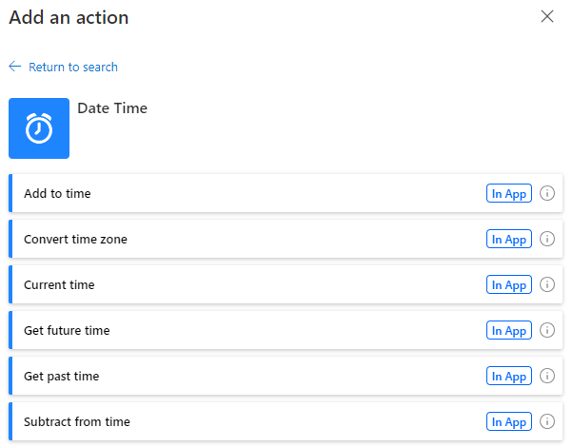
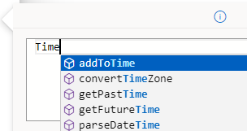
Working with Dates
No date time datatype
Date time is in ISO 8601 format (json)
2022-11-30T20:46:27+10:00
Date Time connector
Or expressions
Date parameter includes only date without time or timezone. To compare parameter dates
< ≤ ≥ > == ≠ all bad as you’re comparing strings
Convert to ticks
Use substring to restrict what are we comparing, e.g., first 10 characters would give you the date only
Notes:
Logic app docs for more details on expressions https://docs.microsoft.com/en-us/azure/logic-apps/workflow-definition-language-functions-reference#date-and-time-functions
Ticks returns the number of ticks, which are 100-nanosecond intervals, since January 1, 0001 12:00:00 midnight

Slide 29
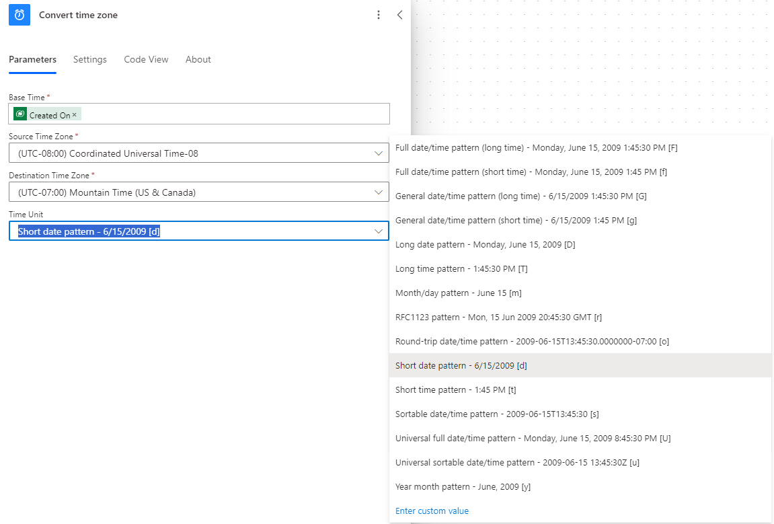
Preparing Dates for Display

Slide 30
Examples Using Expressions with Dates
Get days since account was created
int(
div(
sub(
ticks(utcNow()),
ticks(triggerBody()?['entity']?['createdon'])),
864000000000
))
Check if date is between business hours
and(
greaterOrEquals(
formatdatetime(utcnow(),'HH:ss’),
formatdatetime('7:00','HH:ss')),
lessOrEquals(
formatdatetime(utcnow(),'HH:ss’),
formatdatetime('15:00','HH:ss’))
)
Notes:
This is to show an example of what is possible, not something everyone should be expected to use expressions for, don’t feel you need to dig in and explain the parts just the type of scenarios that can be handled

Slide 31
Complex Data Types in Flows
["Jane","Dan","Steve"]
Most data types (strings, numbers) are “primitives”
There are two types of complex data types: Objects and Arrays
Working with Objects and Arrays can require writing JSON (JavaScript Object Notation)
{
"ID" : 123,
"Name" : "Jane",
"Email" : "J@a.c"
}

Slide 32
What can you do with arrays?
Jane
8.29
ID: 123
Name: Jane
Mail: J@a.c
Common tasks with arrays
Repeat an action over each list item
Get a single item from a list
Filter a list down
Make a list work with a different action
Dan
4.89
ID: 888
Name: Bob
Mail: B@a.c
Steve
0.28
ID: 456
Name: Dave
Mail: D@a.c

Slide 33
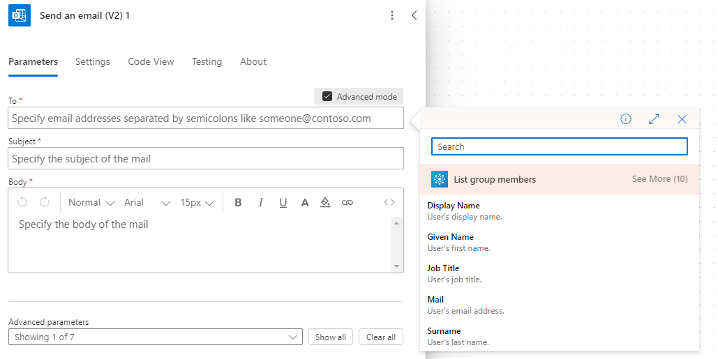
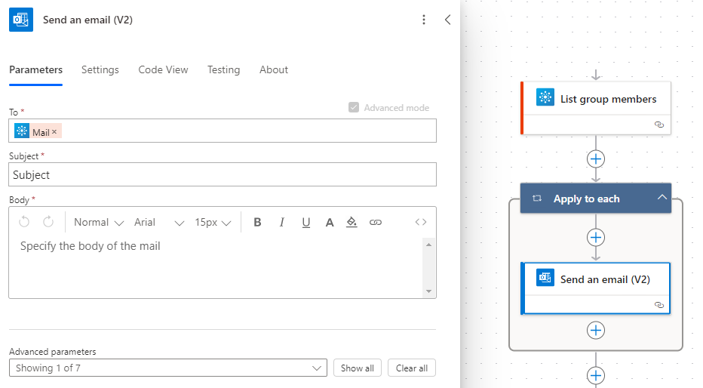
Apply to Each
Automatically added when you try to use an output that’s part of a list
Destination step to repeat over every list item
If you do NOT want this, you can:
Get only one list item using an expression using index [], or
Convert the whole list to a string in the form of a list or a table

Slide 34
Getting Certain List Items
0
Use the first() expression to get the first item from a list
Use square brackets and a number (starts at 0) to get a certain item, for example [2]
Use the last() expression to get the final item
1
2
3
Note: If the array is a list of Strings, Numbers, Booleans etc., then the above expression can be used directly. However, if it is an array of objects, you will need to use square brackets to select the specific property you need
last(body('Get_rows')['value'])['mycolumn1']
body('Get_rows')['value'][2]['mycolumn1']
Notes:
first() is often useful when you know that you only have one record returned but want to avoid loops. For example, when listing accounts from Microsoft Dataverse where you have a filter query on the account id

Slide 35
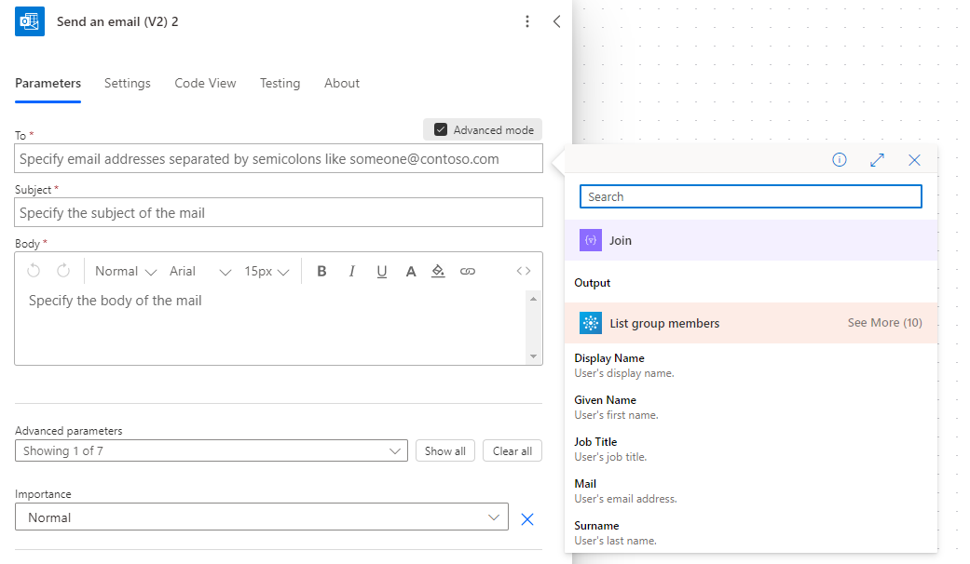
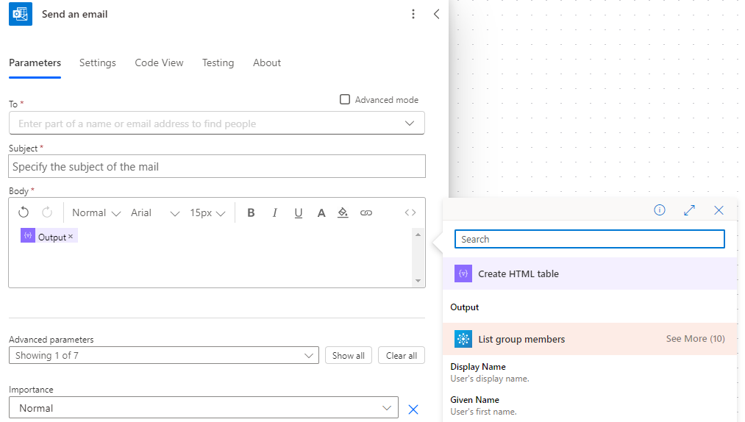
Convert the List to a String
Join – Use join to get a simple list, for example, if you have a list of email addresses*
Create HTML/CSV table – Convert a list of objects to a tabular display format, for example, for inclusion in the body
* Note: You must have a list of strings, not a list of objects

Slide 36
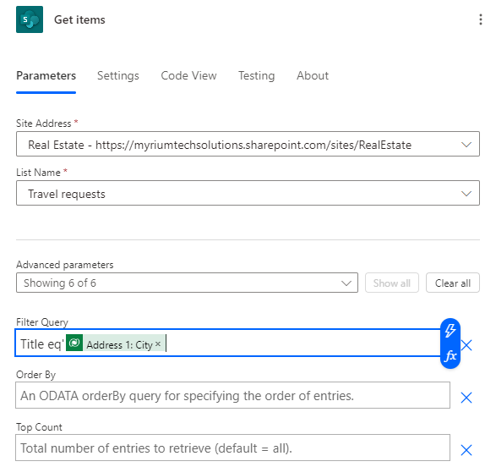
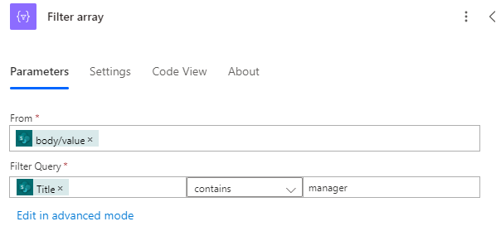
Filtering
Have the connector do the filtering for you – Recommended
Built-in flow action – Filter array
Select the array in the From field
Can either use simple or advanced mode just like for conditions
If you need the first N items you can use take() or skip()

Slide 37
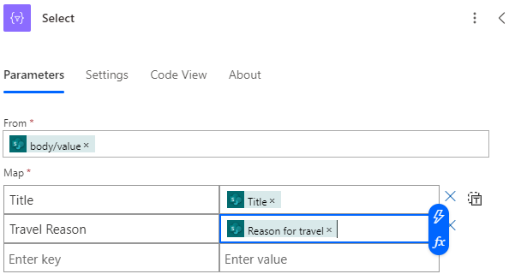
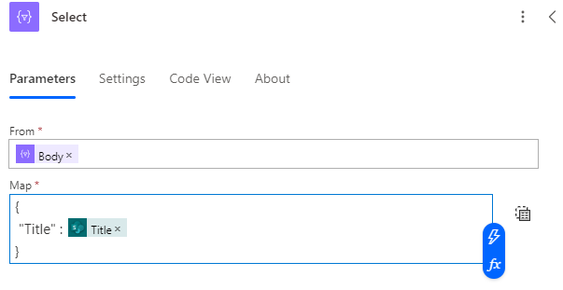
Transforming Arrays
Two input modes: Fill key-value pairs, or typing directly
Create an array of objects
Create an array strings, numbers, Booleans etc.
Useful for passing this array to another action
Useful for getting a simple list, for example, of email addresses

Slide 38
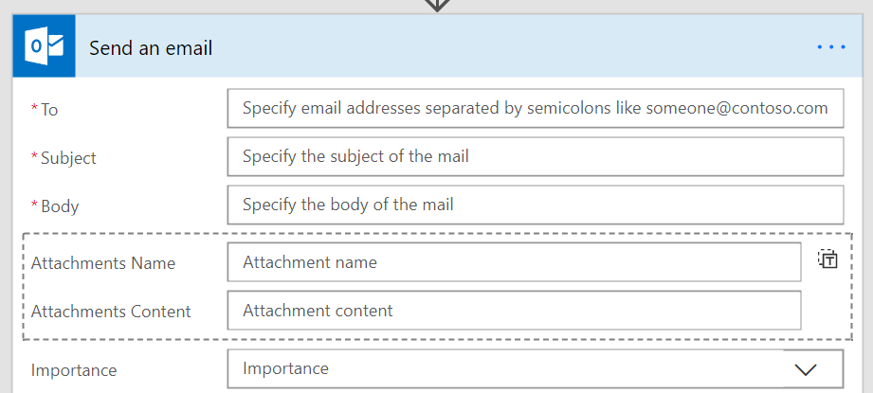
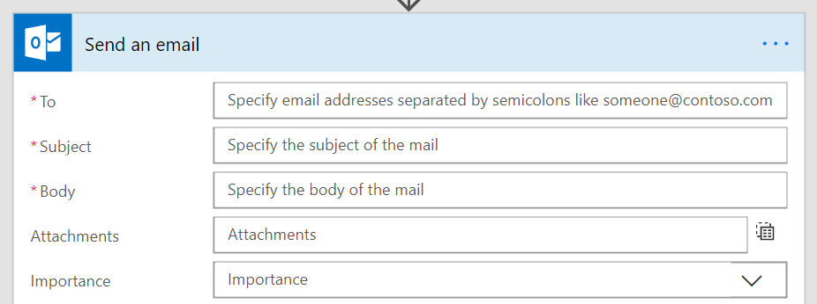
Passing Data Into Arrays
Can hardcode a list – or – have the list be dynamic at runtime
Fill in each property of the object and get one item created
Need to pass in an array that exactly matches the fields

Slide 39
Checking List Containment or Duplicates
1
You can use the contains() expression to see if something is in an array
2
Use the union() function with the array twice to get a set of unique items

Slide 40
Building Objects Directly
You may need to use Compose to build an object or an array. Use JSON syntax on the Compose action
{
"key" : "value"
}
[
"Bob",
"Jane"
]
Expressions to build objects or arrays, such as setProperty, addProperty or removeProperty

Slide 41
Escaping Rules
1
When you are directly using the expression language you may need to escape certain characters
2
Using strings with a single quote character
3
@substring(‘It’’s A Great Day!’,1,5)
4
Using spaces in action names: @body(‘Name_with_spaces’)
5
Building an object you need to escape ‘@’
{
“@@Odata.type” : “”
}

Slide 42
Using Objects
1
set/get/addProperty
2
Returns the object
3
To set variable use intermediate Compose
4
Keep flow compact
Declare variables of type object for related data, e.g., incrementing periods:
{ “unit”:’month’, “quantity”: 1, “minimum”: 2 }
Setting the value
setProperty OR
set variable to json(‘{ ”unit”: ”Week”, ”quantity”: 2, ”minimum”: 7 }’)

Slide 43
Getting Creative
1
Apply for each
Apply to each on createArray(1,2,3,4)
Use inline object [1,2,3,4]
2
Using maps
{ 1:”one”, 2: “two”, 3: “three” }
Choice list in Microsoft Dataverse
Getting random string
createArray(‘Hi’, ‘Hello’, ‘Howdy’)[rand(0,2)]
Notes:
Arrays can be created inline using expressions and can be used for building an apply for each or a mapping array

Slide 44
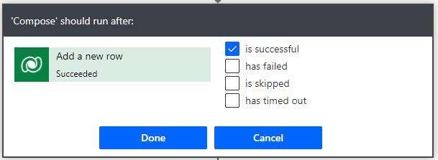
Error Handling Overview
Default configuration is to only run if prior step is successful
Retry policies are on by default and exponentially retry before fail
Most actions are independent units of work and prior work does not auto rollback – You must implement your own compensation
Try – Catch – Finally is a good pattern to follow
Notes:
Suggest that makers review their retry settings as default values complete quickly

Slide 45
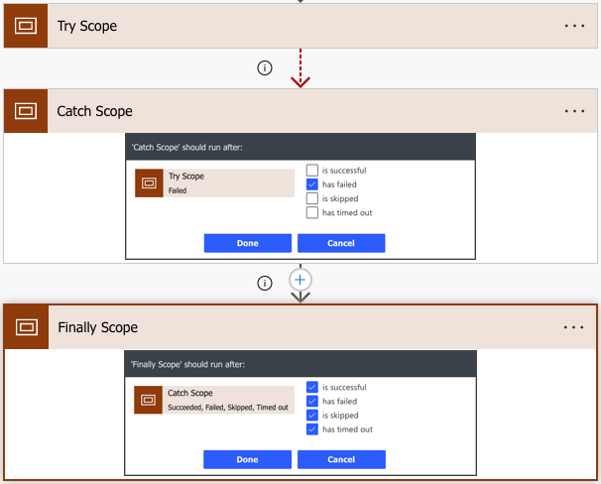
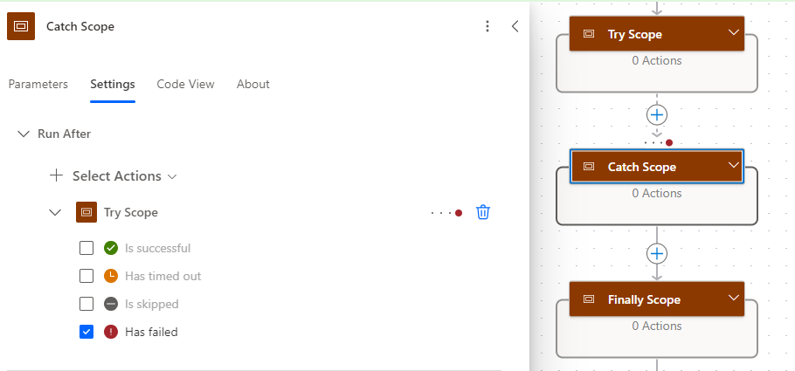
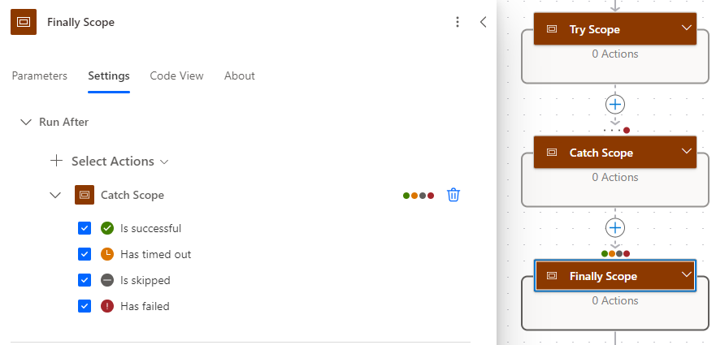
Try – Catch – Finally
Catch only runs when Try has failed
When Try runs successfully, Catch scope is skipped
Finally runs regardless of the Catch execution including when it is skipped

Slide 46
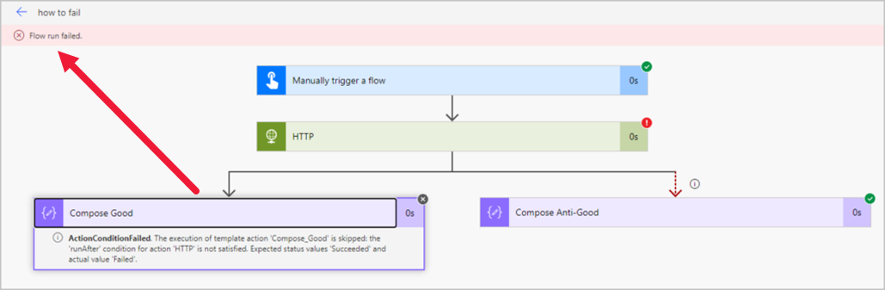
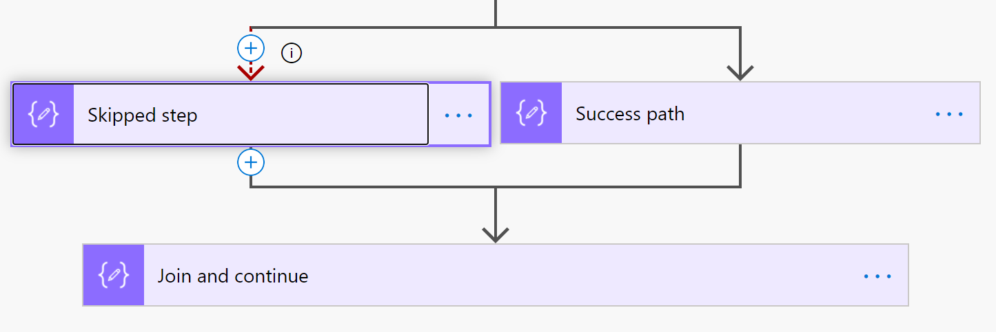
Errors and Flow Success
For a flow run to be a success, all execution paths must complete
That includes paths that contain skipped actions
Solutions
Join the paths
Terminate the branch
Notes:
Tip #1359: Whose fault is it in Power Automate? | Power Platform & Dynamics CRM Tip Of The Day (crmtipoftheday.com)

Slide 47
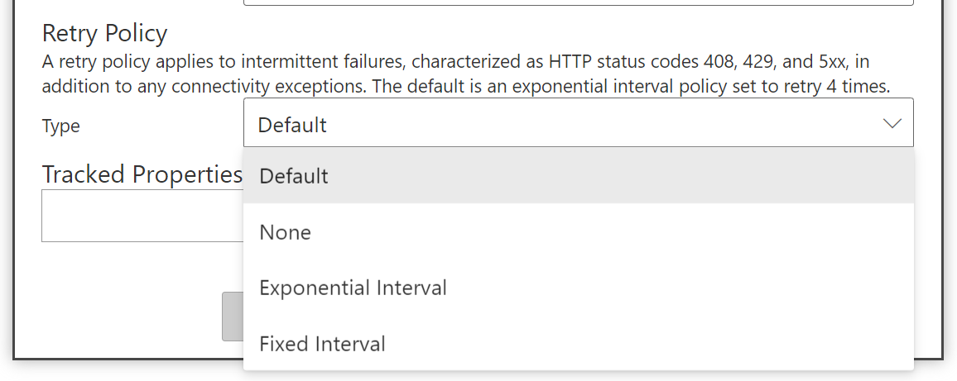
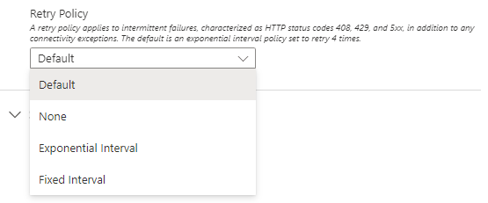
Changing Retry Policy
Retry policy applies to intermittent failures, characterized as HTTP status codes 408, 429, and 5xx, in addition to any connectivity exceptions
Adjust the retry policy to handle unique service scenarios

Slide 48
Exercise: Creating a Manual Flow and Using Expressions
Follow the exercise on Learn
Time estimate: 15 minutes
Notes:
https://learn.microsoft.com/en-us/training/modules/introduction-expressions/6-exercise

Slide 49
Module 2 – Summary
How to configure flow control in cloud flows including loops
Use of expressions in cloud flows
Common processes for parsing text including JSON, XML, and CSV in cloud flows
How to configure variable actions for cloud flows
How to implement data objects in cloud flows
How to configure timeout and retry policies in cloud flows
How to use exception handling blocks in cloud flows to handle system exceptions
How to use error handling routines in cloud flows to handle business exceptions

Slide 50
Module 3: Advanced Flow Scenarios

Slide 51
Module 3 – Introduction
Implement sophisticated business processes and logic using advanced flow techniques along with the application of Microsoft AI for document and data processing.
In this module, you will:
1
Create and use child cloud flows including passing in and returning the data
2
Perform actions in cloud flows by calling external APIs
3
Configure filter conditions and concurrency in cloud flows
4
Configure cloud flow action to run Microsoft Office Scripts
5
Identify Microsoft AI options for processing documents in desktop and cloud flows
6
Identify Microsoft AI options for processing data in desktop and cloud flows
7
Identify use cases for the Document Automation Toolkit
8
Configure document processing by using AI Builder
Notes:
Prerequisites
Basic familiarity with the Power Automate for desktop console

Slide 52
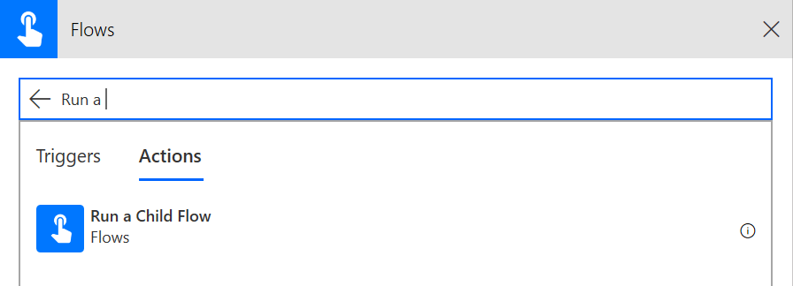
About Child Flows
Allows breaking out parts of a flow into a reusable child flow
Trigger support of child flows
Manually triggered button flow
Power Apps
HTTP request
Respond with Power Apps or HTTP response
If no response action, parent won’t wait
Solutions are required for this to work
Notes:
Manual – Use this when you also want your child flow to be run interactively as well as a child flow.
Power Apps – This is the most general purpose way to use child flows – also allows reuse from a canvas app, but does not allow users to run manually. Definition of parameters is done visually
HTTP Request – This is the most powerful trigger for child flows, input options are defined with JSON sample or JSON schema and are not limited to the fixed parameters of the other options.

Slide 53
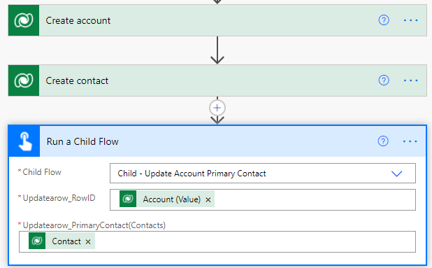
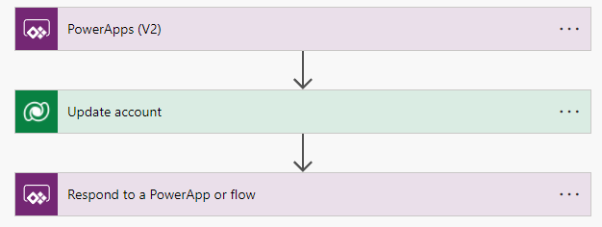
Example – Using a Child Flow
Parent flow
Child flow
Notes:
Example – refactors out updating the primary contact on an account – could include other actions like scheduling call with new contact etc.

Slide 54
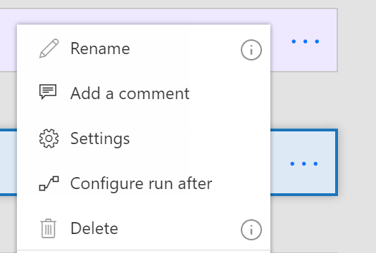
Action Settings
The “…” menu contains entry points to Settings and Configure run after
Settings lets you configure
Async actions
Timeout
Retry policy
Sequential
And more!

Slide 55
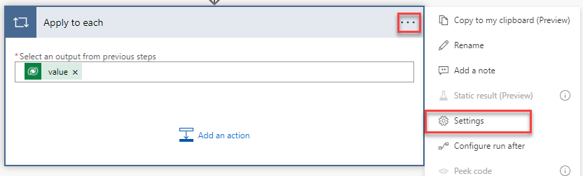
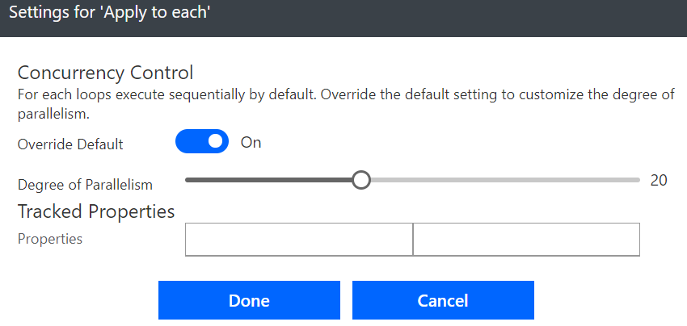
Run for Each Item in Parallel
By default, runs one at a time.

Slide 56
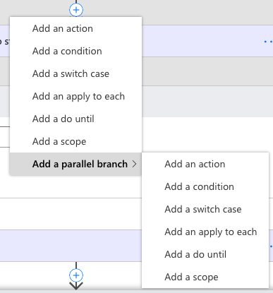
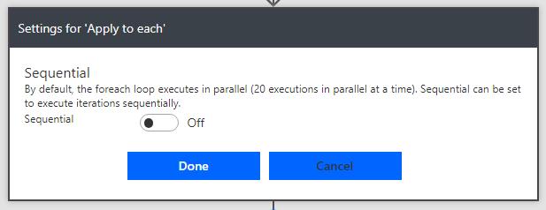
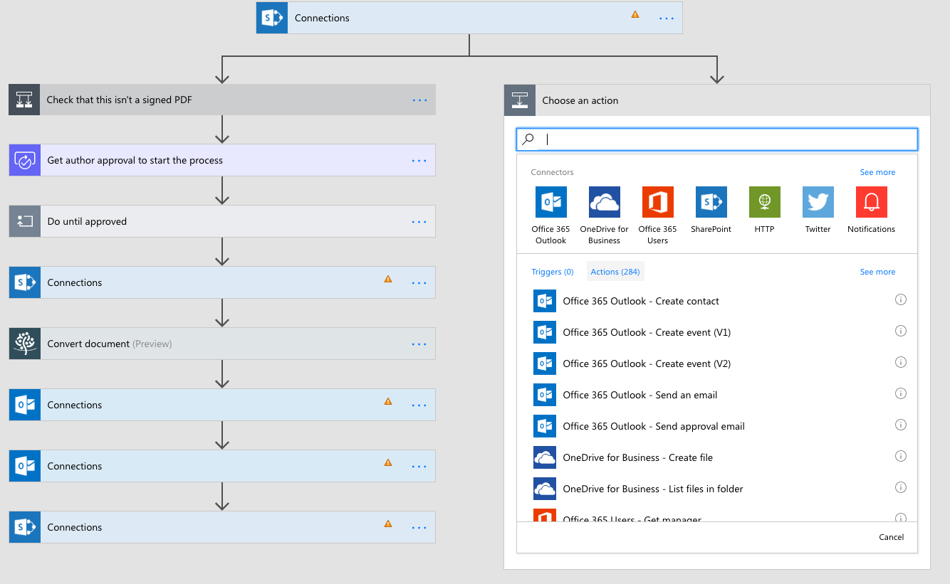
Parallel Execution
For actions select Add parallel branch from the above the action
Inside of a foreach you can do up to 50 at a time

Slide 57
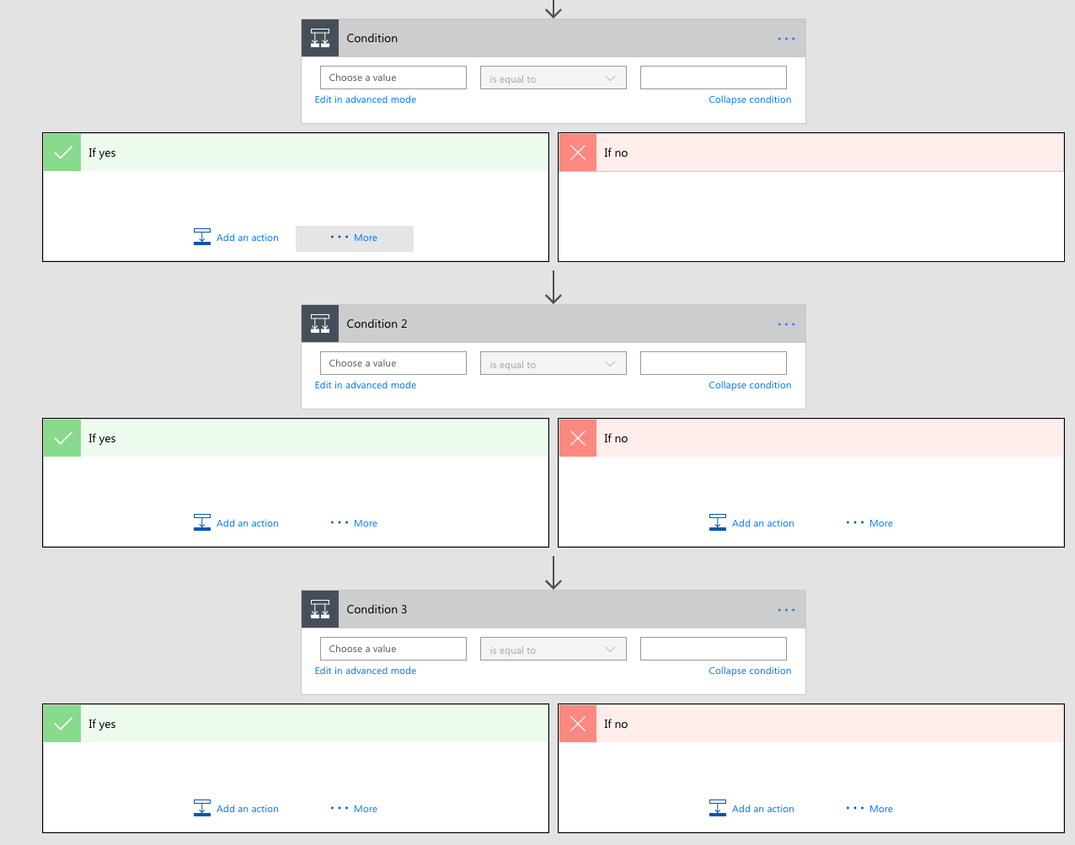
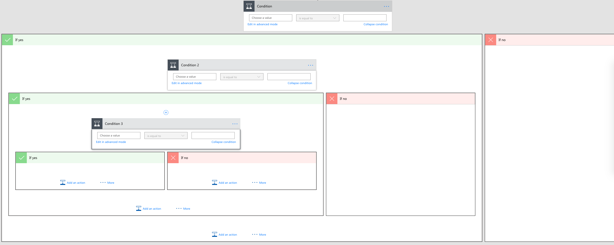
Terminate Flows
You can use this action to avoid nested conditions by ending in the middle

Slide 58
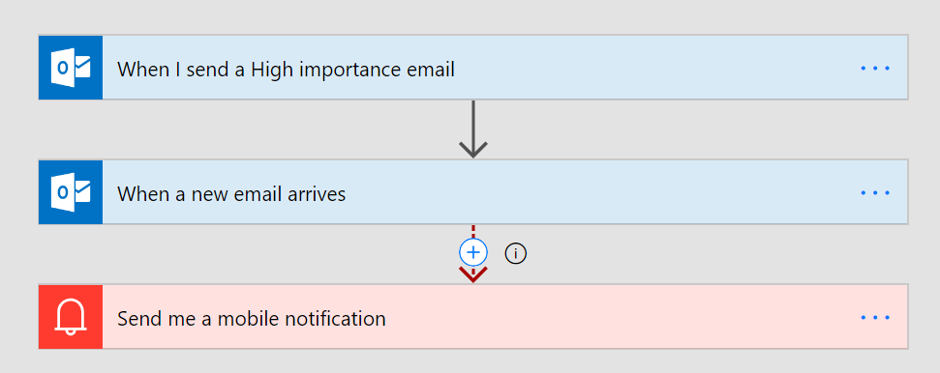
Asynchronous Actions
Any “trigger” can be in the middle of a flow as well
For example, create a flow that waits for a reply to a certain thread in the middle
You probably want to configure a time out and handle that case
Notes:
This allows you to wait inline for something to happen, for example you could wait for a Microsoft Dataverse record to be updated to a specific value before you proceed
the HTTP + Webhook action as that is similar to this

Slide 59
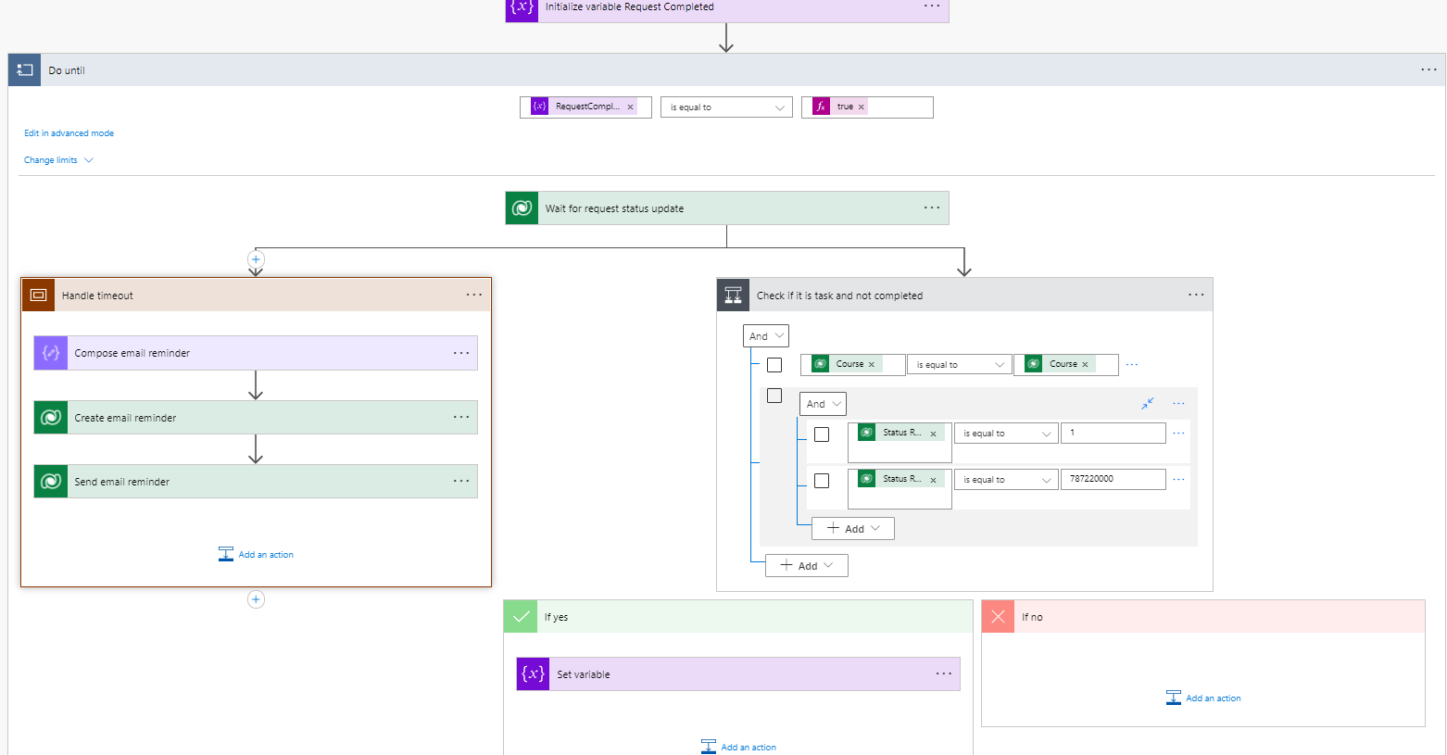

Wait Until Pattern

Slide 60

Using Settings → Trigger Conditions
Use flow expressions for filter
Works on create and update
Not available if trigger is used later in flow

Slide 61


Run Office Scripts with Power Automate
Power Automate integration with Office Scripts enables workflows that can interact with and manipulate Office documents
Office Scripts use TypeScript
Create a flow from Excel
Excel Online (Business) connector
Caveats
Increased complexity
Error propagation
Permission issues
Potential data loss
Throttling limits
Notes:
Benefits & reasons
Automation and Efficiency: Office Scripts allow you to automate repetitive tasks in Office applications like Excel, thereby increasing efficiency.
Seamless Integration: Power Automate's integration with Office Scripts enables workflows that can interact with and manipulate Office documents.
Increased Productivity: By automating tasks, you free up time to focus on more complex, higher-value work.
Complex Task Handling: Office Scripts can handle complex tasks and calculations in Office apps that aren't directly supported by Power Automate.
Custom Functionality: You can create custom functions and methods within Office Scripts to tailor your automation to your needs.
Data Manipulation: Office Scripts in Excel, for instance, allow for robust data manipulation, analysis, and transformation as part of a flow.
Caveats
Increased Complexity: Although powerful, Office Scripts can add complexity to your flows, potentially making them harder to debug and maintain.
Error Propagation: Mistakes in Office Scripts can propagate through your flows, leading to incorrect data manipulation or erroneous results.
Permission Issues: Office Scripts require appropriate permissions to access and manipulate data, which can sometimes lead to access-related errors if not set up correctly.
Potential Data Loss: Be cautious when writing scripts that modify data. Improper use can unintentionally overwrite or delete important information.
Throttling Limits: Office Scripts in Power Automate are subject to service limits, and heavy use can lead to throttling, impacting the flow's performance.
Regenerate response

Slide 62

Pass parameters
Script parameters after the mandatory workbook: ExcelScript.Workbook are mapped in run script action
Optional parameters with ?modifier Name?: string
Defaults are assigned location: string = “Seattle“”
Dropdowns can be used location: “Seattle” | “Redmond”
Supported types: string, number, boolean, unknown, object, and undefined
Objects and arrays are supported and can be nested

Slide 63

Return Data
Scripts can return data from the workbook function main(workbook: ExcelScript.Workbook): string
Used as dynamic content “result” in a Power Automate flow
Same type support as for input

Slide 64
Call External API in Power Automate
1
An Alternative to Connectors
Quickly integrate with services without connectors.
Custom operations for specific use cases, special methods and headers.
Simplifies by removing abstraction layers that come with connectors.
2
Connectors
HTTP connector to invoke external services
HTTP with Azure AD connector for internal
Office 365 Groups (Send an HTTP request) – Simplified call to Graph API
3
Caveats
Requires technical knowledge to set up and handle API responses, error handling, and authentication protocols.
Authentication protocols like OAuth2 can be challenging to implement.

Slide 65
AI Options for Document Processing
1
Automating Invoice Processing: Streamlines accounting tasks.
2
Contract Analysis: Extracts key details from contracts.
3
Automating Data Extraction: Reduces manual data entry from forms.

Slide 66
AI Options for Data Processing
1
Prediction: Predicts outcomes based on patterns in your data.
2
Category Classification: Classifies text into custom categories.
3
Object Detection: Identifies and locates objects within images.

Slide 67
Document Automation Toolkit
1
Automating Invoice Processing: Streamlines accounting tasks.
2
Contract Analysis: Extracts key details from contracts.
3
Automating Data Extraction: Reduces manual data entry from forms.

Slide 68
Steps to Implement AI in Power Automate
1
Access AI Builder: From the Power Apps home page, select AI Builder > Build.
2
Choose Model Type: Select “Form Processing” to process structured documents like forms.
3
Train the Model: Provide a set of at least five documents to train the model.
4
Test the Model: Use different sample documents to test the model's accuracy and adjust if necessary.
5
Publish the Model: Once you’re satisfied with the model’s performance, publish it.
6
Use in Power Automate: In your flow, add a new “Predict” action and select your newly published AI model.
Note: This process requires some understanding of your document data and requires the model to be retrained when the document format changes.

Slide 69
Module 3 – Summary
Create and use child cloud flows including passing in and returning the data
Perform actions in cloud flows by calling external APIs
Configure filter conditions and concurrency in cloud flows
Configure cloud flow action to run Microsoft Office Scripts
Identify Microsoft AI options for processing documents in cloud flows
Identify Microsoft AI options for processing data in cloud flows
Identify use cases for the Document Automation Toolkit
Configure document processing by using AI Builder

Slide 70
Module 4: Deploy and Monitor

Slide 71
Module 4 – Introduction
How to implement Power Automate cloud flows into a production environment and oversee their performance and efficiency.
In this module, you will:
1
Manage configurations by using environment variables
2
Identify and troubleshoot cloud flow issues
Notes:
Prerequisites
Basic familiarity with the Power Automate for desktop console

Slide 72
Using Environment Variables
1
Flow modifications introduce unmanaged layers
2
Environment variables allow changing configuration without modifying the flow
3
Easier deployment across multiple environments in ALM processes
4
Example: Separate external endpoints for testing/production
5
Environment variables allow for referencing secrets stored in Azure Key Vault
6
Data types include
Decimal number, text, two options
JSON (multiple configuration options in one place)
Data source (connector configuration)
Secret (Azure Key Vault configuration)

Slide 73
Topics
Testing
We review what you should know about the different testing methods and the pros and cons of each.
Performance
Troubleshooting
When things go wrong, you need to know where and what to look for and the best ways to get it working again.
You want to create flows that are efficient, effective, and perform reliably at scale.

Slide 74

Easy Checking and Real-time Testing
Power Automate checker helps determine errors in the flow design
Real time testing to ensure your Power Automate works

Slide 75

Power Automate Checker
Error is something that is guaranteed to fail. The most common example is omission of a field that’s required.
Warning is something that may or may not cause the flow to behave in an unexpected way. An example is infinite loops.

Slide 76
Testing methods
Real example data
Previous run data
On demand

Slide 77

Real Example Data
Last data that would trigger the flow, e.g., last event created
Limited connectors
Office 365 Outlook
SQL Server
Gmail
Outlook.com

Slide 78



Previous Run Data
Go to the run history view and select Resubmit
Use the Test flow button directly in the designer.
Perform the trigger action yourself
Use data from previous runs.

Slide 79
Effective Testing
Use the built-in testing capabilities along with the flow checker to test, review, and modify the flows
Iterate — Build your flow one piece at a time, validate, and then expand
Use tested and proven child flows
Use button triggers when possible, then use the actual trigger
Notes:
the easiest way to test a flow is button trigger. It may not always be practical

Slide 80
Testing Tips & Traps (1 of 2)
1
Prior runs
Filtering of scope in the Microsoft Dataverse trigger is not performed
Most helpful when a failure occurs (keep rerunning the failed record)
Danger of stale data, especially dates
Don’t rely on timestamps
Watch out for relative dates (stale data)
2
Runaway flows
Flows triggering themselves
Infinite loops

Slide 81
Testing Tips & Traps (2 of 2)
1
Test with realistic data
Data sets are either too large or too small
Loops (set appropriate counts and timeouts)
Data validation
2
Be careful testing with live services
Financials, notifications, real customers
Have to compensate transactions or perform a clean up
Use mock services if using custom connectors
3
Testing changing the results
Ensure the starting point for repeatable testing
Notes:
watch for throttling, plan doesn't support the number of API calls that is allocated, that can result in throttling.

Slide 82



Static Results
Doesn’t run the action, returns the static data
Where to use
Service is not ready
Costs
Throttling
Side-effects or irreversible actions
“Too reliable” – Negative path testing (service fails)
Results are volatile – Predictability in testing
What can you do
Run different condition paths
Force errors
Provide specific message response bodies
Skip some steps
Reuse previous outputs from real runs
Example
Send an email
Limitations
One scenario per action (copy flow)
No ability to turn it on or off dynamically
Notes:
Hint: if it’s disabled, save and reopen flow.

Slide 83
Troubleshooting
1
Use Resubmit to rerun with the exact same data.
2
Configure “run after” to get immediate notification for flows that aren’t completing.
Scopes can be used in a “try catch”
3
Understand the flow execution limits and design the flow to stay within those limits.
4
Be on the lookout for flows that would create an endless loop.
Notes:
Process failed flow runs using the resubmit function to rerun the flow with the exact same data.
Configure “run after” to get immediate notification for flows that aren’t completing.
Understand the flow execution limits, and design the flow to stay within those limits.
Be on the lookout for flows that would create an endless loop.

Slide 84
Troubleshooting Tips
1
How to isolate the problem
Known clean steps (child flows) – Bypass them or return fixed result
Use Outputs – Look at the data
The most useful is the output of the step before the failed one
Use compose (like a debug output)
Actually identify what failed
E.g., error is inside if (screenshot) – Make sure to drill in.
Skipping is treated as a failure (screenshot)
When in the loop use “next fail”
2
Flow does not have a concept of a “current” record
It’s always a snapshot from when the record was retrieved

Slide 85

Common Issues
Trigger not firing
The flow will not even start
May not show up in the run history list
Slow flow
Actions seem to be running slowly
May appear to get stuck on a single step
Distinct from triggers not firing

Slide 86


Trigger not Firing
Follow the link
Inspect the underlying error message
Common issues
A change in the connection that the flow is using (e.g., password expired)
A trigger input that is invalid (schema validation failure)
Failure to register a webhook trigger
Failures with 5xx status codes are typically system issues. Most of the times self-heal eventually.

Slide 87
Slow running flows
1
The service you are connecting to is running slowly
A slow running SQL query
2
Connector throttling
Usually error 429 (too many requests)
Most connectors document their throttling limits
3
Platform throttling – Excessive number of actions per day
Every card in a flow that gets executed counts as an API call (action)
Occasional and reasonable overages are OK
Use analytics tab of the flow details page to diagnose actions usage
4
Exceeding the data consumption allowance per day
5
Exceeding a documented limit
Notes:
your license can impact your entitlement form a platform prospective

Slide 88

Fix Flow Failures
Repair tips in email
Identify the error
Drilldown into failed flow and step
Authentication failures
Errors 401 or 403
Usually fixed by updating the connection
Action configuration
Typically other 4xx errors
Error details may contain hints
Can resubmit after a fix
Other failures
5xx are usually transient – Use Resubmit

Slide 89
Module 4 – Summary
Manage configurations by using environment variables and configuration files
Identify and troubleshoot cloud flow issues

Slide 90
Closing slide

